Slide 1
PRO-COAST
SESF implementation from GEMCONBIO and TESS

Slide 2
PRO-COAST – WP4 Framework Operationalising D4.1 SES framework design, variable selection, and measurement proxy development
This includes key variables describing a SES and its dynamics, such as behaviour, lifestyles, religious, societal and cultural indicators and ecosystem services parameters related to climate and the NBS implementation (linked to T4.1):
  Literature review leading to new framework concept including Key System Archetypes
  Now need to include list of research questions (some from D2.1?)
  Then to define variables to address those research questions
  Then simple survey questions to test in case studies and for Community Sustainability Platform
ESUG’s experience from GEMCONBIO & TESS can help
  GEMCONBIO developed framework, groups of research questions, then variables, then survey questions
  GEMCONBIO tested 73 questions by detailed interviews of 26 local cases & across 6 organisations
  TESS published analysis in PNAS and modified questions for 30 national surveys & 8 local cases
  Country Coordinators translated 57 questions for phone/online survey: LAU2 council, stakeholders
  150 samples via lists of random local authorities: 90% of first-on-list obliged in 28 of 31 countries

Slide 3
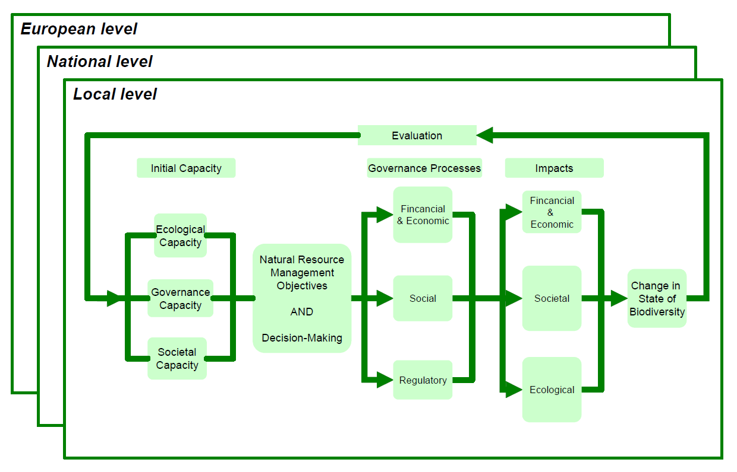
A stylized representation of the GEM-CON-BIO analytical framework cycle.

Slide 4
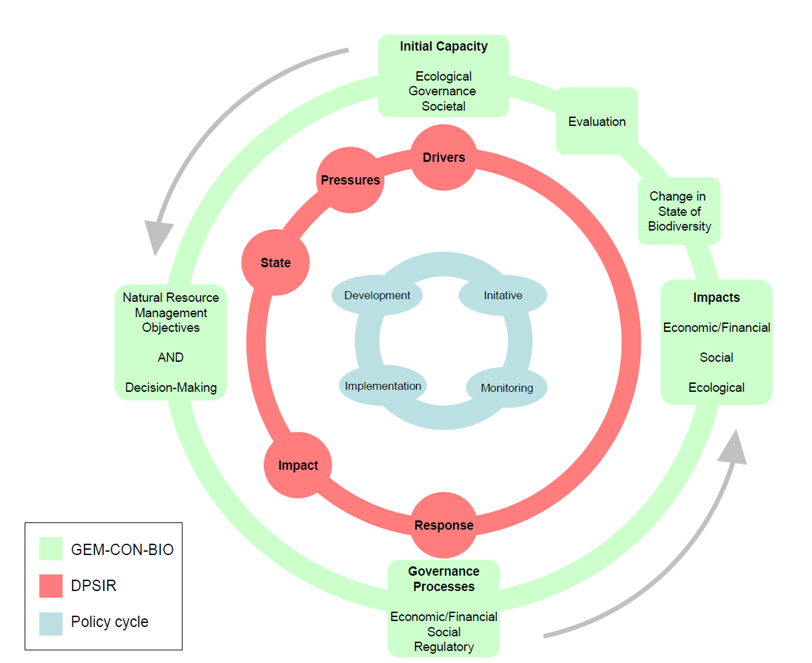
A stylized representation of the relationship between the GEM-CON-BIO analytical framework and the DPSIR framework and also the policy development cycle

Slide 5
Aims of the clusters of research questions
To assess the role of different governance approaches on the management of ecosystems and protection of biodiversity, analysis was carried out on 73 research questions clustered as follows:
Natural Capacity: Identifies key habitat types and ecosystem services to be assessed.
Socio-economic Capacity: Starting conditions pressure the way ecosystems are used & managed.
Governance Capacity: Indicators mostly relate to data from the national level, e.g. the rule of law.
Regulatory Capacity: Questions about the coherence of the legislative framework both within and outside environmental legislation and whether laws and policies are enforced and funded properly.
General social capacity: Of social capital (e.g. trust) & biodiversity values in country & case studies.
Natural Resource Management: How strategic management plans provide tools and steering.

Slide 6
For more on GEMCONBIO, see pages 27-42 at: https://www.sycl.net/file_link/00154/GEMCONBIO_638502544358372180.pdf
Governance processes: How the processes (regulatory, financial/economic, societal) balance.
Regulatory: Extent to which regulatory mechanisms in laws or policy documents operate.
Economic and financial: Tools for sustainable use and conservation of biodiversity.
Societal: How social components, like stakeholders, function & interact in different circumstances.
Impacts: of instrument types for managing natural resources, from financial tools to policy groups.
Financial and economic impacts: on local community, stakeholders and their economic activities.
Social impacts: on the social interactions among stakeholder groups.
Ecological impacts: of the processes on the surrounding ecosystem in the study area & region.
Evaluation: Provides scope to measure whether the outcomes of management decisions meet their local objectives and support commitments made nationally and to the global processes e.g. CBD. This provides the feedback required to modify the management objectives in the next iteration. A final very important question asks at what level the modification would be best made.

Slide 7
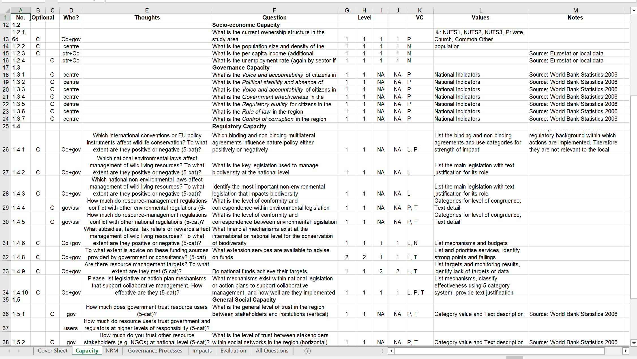
A stylized representation of the relationship between the GEM-CON-BIO analytical framework and the DPSIR framework and also the policy development cycle
One page of the 73 GEMCONBIO questions

Slide 8
The next project designed a Transactional Environmental Support System (TESS) for planning at all levels: National to Individual
Partners worked together to modify Socio-environmental survey questions from GEMCONBIO for application at National level and at the lowest level of Local government, NUTS5 (= LAU2).
Partners in 9 case study countries applied the questionnaires by phone for these government levels (and also obtained data from NUTS4 (=LAU1)) to enquire about planning processes for biodiversity.
Questions that were appropriate for individuals were developed from some questions applied to administrators at an organisational level. All questionnaires for local level were translated by TESS partners or ESUG Country Coordinators (some had both roles).
Local individuals were asked about engagement in biodiversity-related activities and opinions on the conservation benefit of such activities, while managers of land and species were also asked about numbers of decisions they made annually.

Slide 9
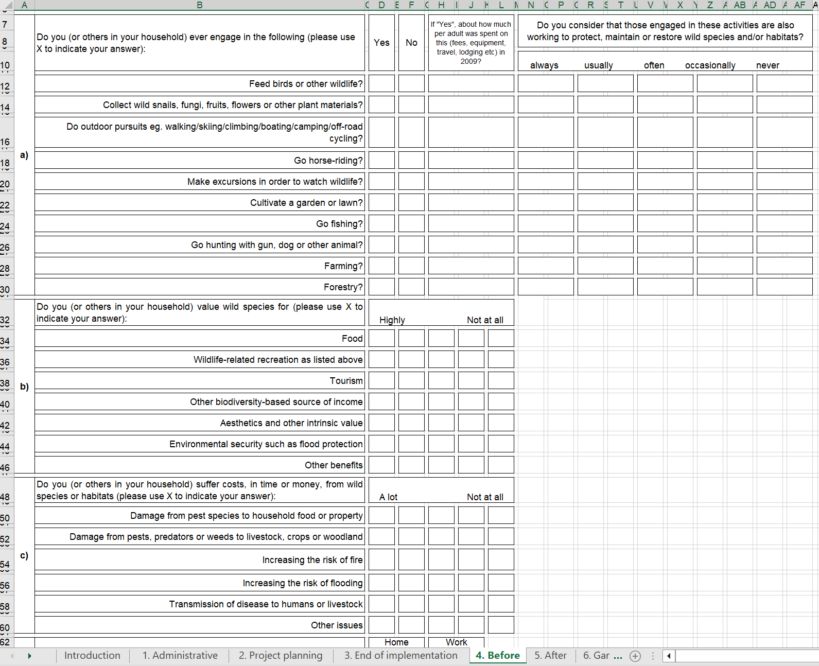
Slide title
Local individuals, as well as administrators at most local government (LAU2) & one tier up (LAU1) were asked about engagement in biodiversity-related activities and their opinions on the conservation benefit of such activities, while managers of land and species were also asked about numbers of decisions made annually.
Individuals were also asked six questions on benefits of Ecosystem Services and six on costs. A ‘cheap and cheerful’ Index of ‘Nature-Positivity’ (NPI) subtracted the average costs from the average benefit scores.

Slide 10
The next project designed a Transactional Environmental Support System (TESS) for planning at all levels: Local Administrations
Questions were then revised, simplified where ambiguities were detected, and used for systematic survey of administrators in up to 150 local governments among the 120,000 listed at NUTS5 level.
ESUG Country Coordinators in 31 countries were asked to translate and survey administrators for local governments (NUTS5) chosen from 5 geographically stratified randomised lists for each state.
Most surveyed by phone, a few visited or had surveys completed online. Three countries failed; in other surveys 90% of 1st LAU2 approached completed for themselves and asked 1-2 individual managers to estimate annual numbers of planning decisions they made affecting land and species.
A Nature-Positivity Index derived from 12 questions about benefits and costs from nature provided an interesting variable on attitudes for organisations as well as individuals.
The next three slides are from the 4-page questionnaire for the LAU2s. Results were analysed but published only in the TESS book because bids to build Reciprocal Environmental Support were not funded until the Community Sustainability Platform approach was approved for Pro-Coast.

Slide 11
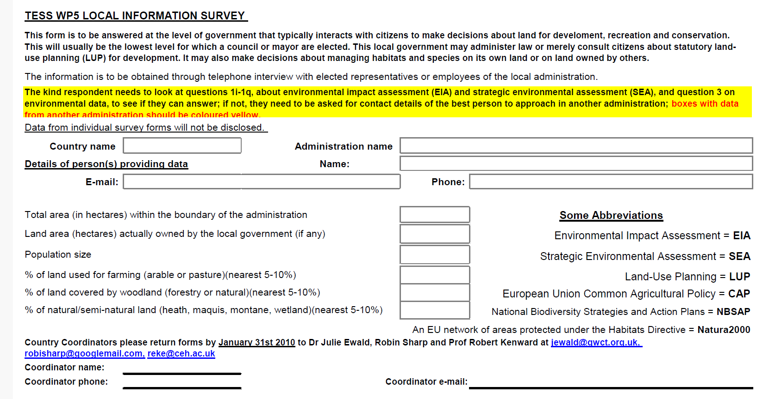
To 150 LAU2s in TESS, intro & 3 pages (last follows)

Slide 12
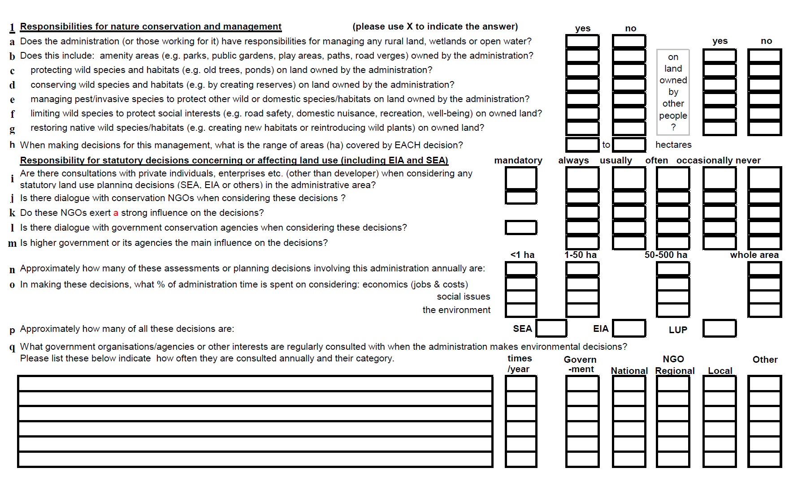
Slide title

Slide 13
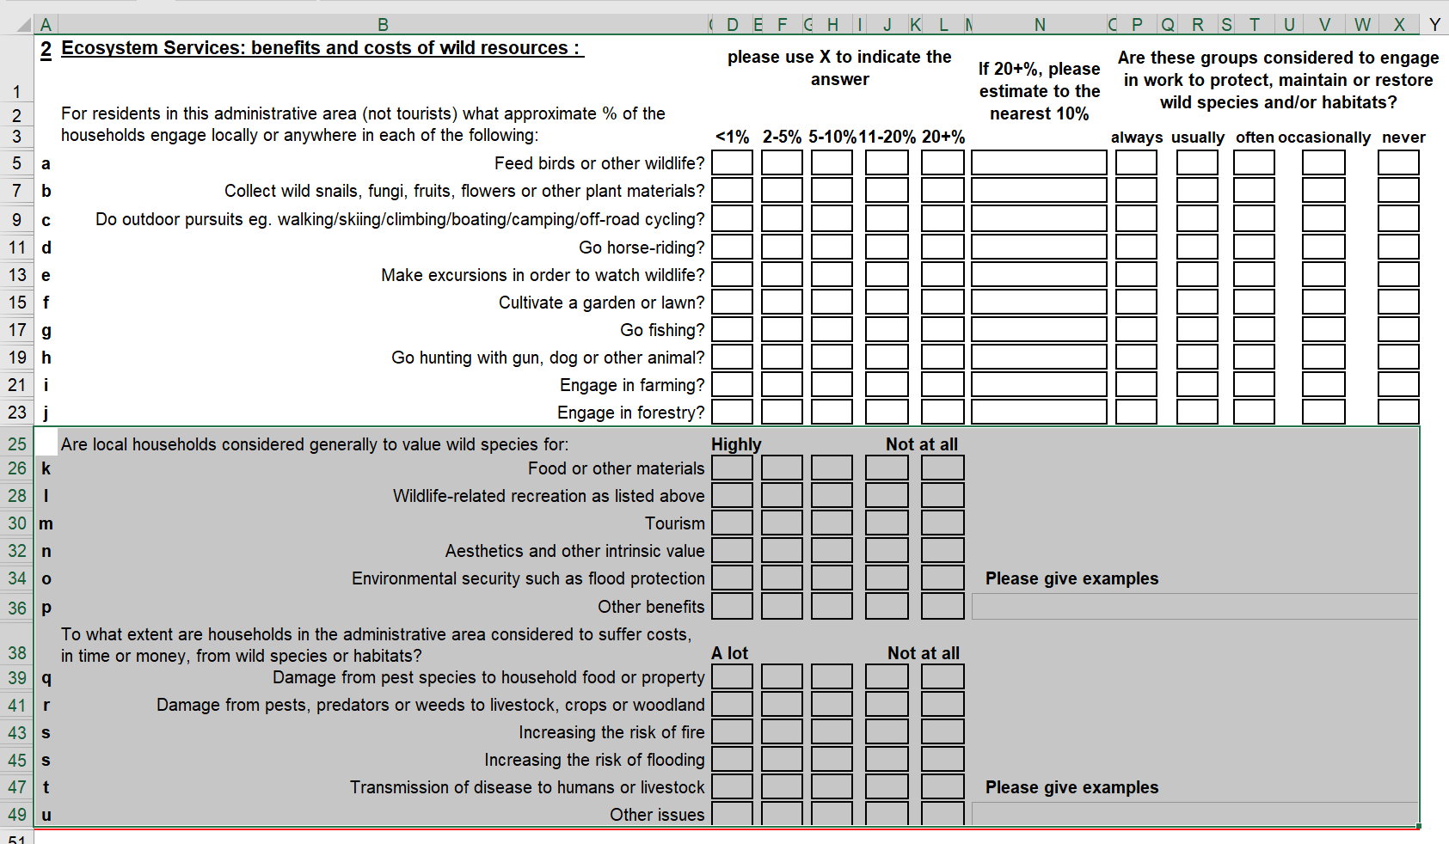
Slide title

Slide 14
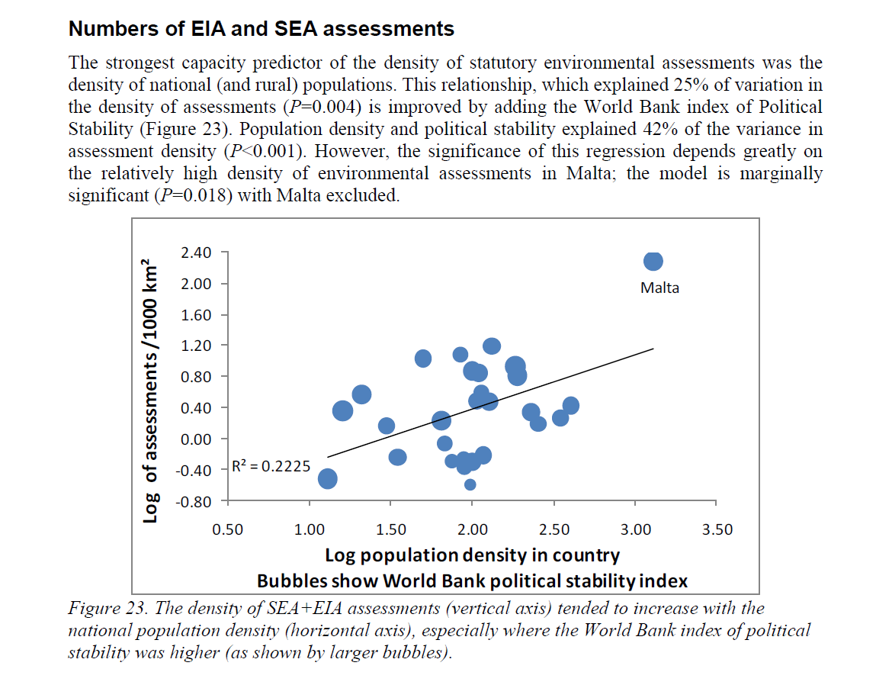
For more on TESS, see chapters at: https://www.sycl.net/file_link/00154/TESS(IGI)exCS_638502543666800760.zip
The grey highlight on the previous slide shows six questions on benefits of Ecosystem Services and six on costs. A ‘cheap and cheerful’ Index of ‘Nature-Positivity’ (NPI) subtracted the average costs from the average benefit scores.
With Environmental Impact Assessments and Strategic EAs a major aspect of TESS (as shown right in relation to demography and political stability), we were surprised that the single strongest relation with EA score was NPI (see next slide).

Slide 15
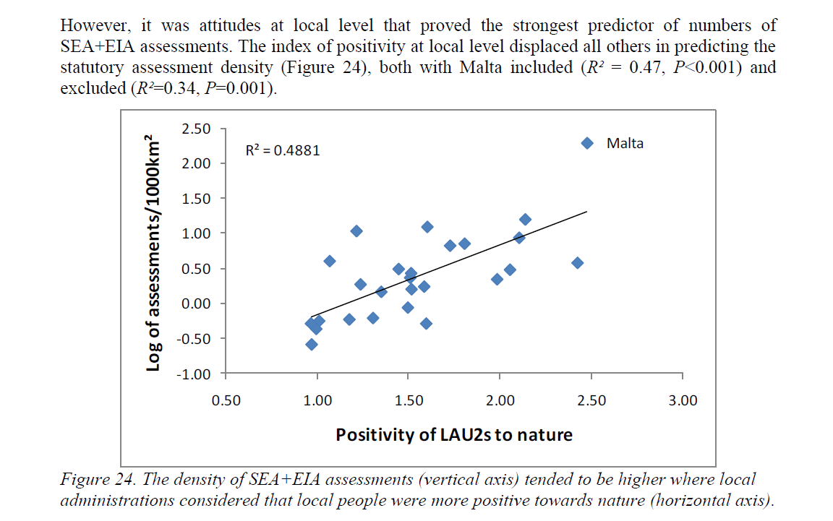

Slide 16
Following TESS: potential for PRO-COAST
ESUG has maintained a Country Coordinator network and built software to facilitate organisation of networked support groups running multilingual websites linked to local-language satellite sites. See www.Naturalliance.eu and www.sakernet.org and www.perdixnet.org and www.Naturalliance.org
Such a network is the basis for the PRO-COAST ‘web-site’, which is already a network of two sites, one multilingual to test content in English before translation and the other an English satellite.
This network forms the basis for the Community Sustainability Platform (CUSP), across which we can (a) exchange information and (b) organise Country Coordination teams for survey as in TESS.
(a) is being used to provide decision support software for the UK Case Study initially, then for others as required and then to attract interest during roll-out of the CUSP across and beyond Europe.
(b) The latter is an option for gathering quantitative data systematically, at national and/or at local community level, if relevant WP teams wish to develop appropriate questionnaires for this.
If the Nature-Positivity Index is considered a useful attitude measure to include in such survey, NPI change over time in relation to national-level changes might provide a high-level publication.
There was even some data on pluralistic ignorance in TESS (see next slide).

Slide 17
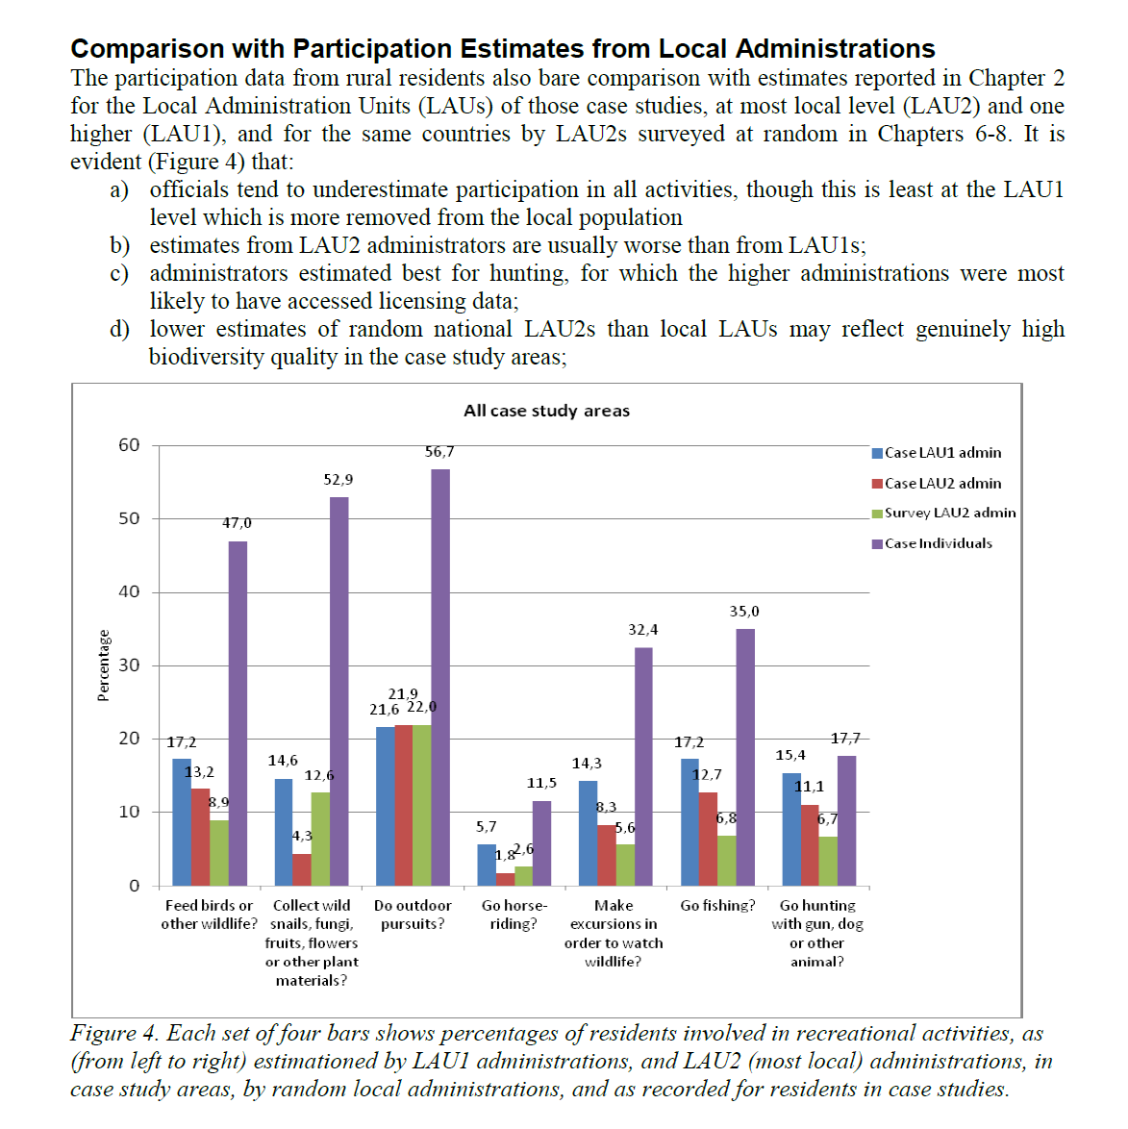

Slide 18
Thank you

