Slide 1
Sycl
System for Community Liaison

Slide 2
Sycl what it is and what it does
Easy to use website editor
Inexpensive
Can disseminate common information to groups
Works across many languages
Mapping ability

Slide 3
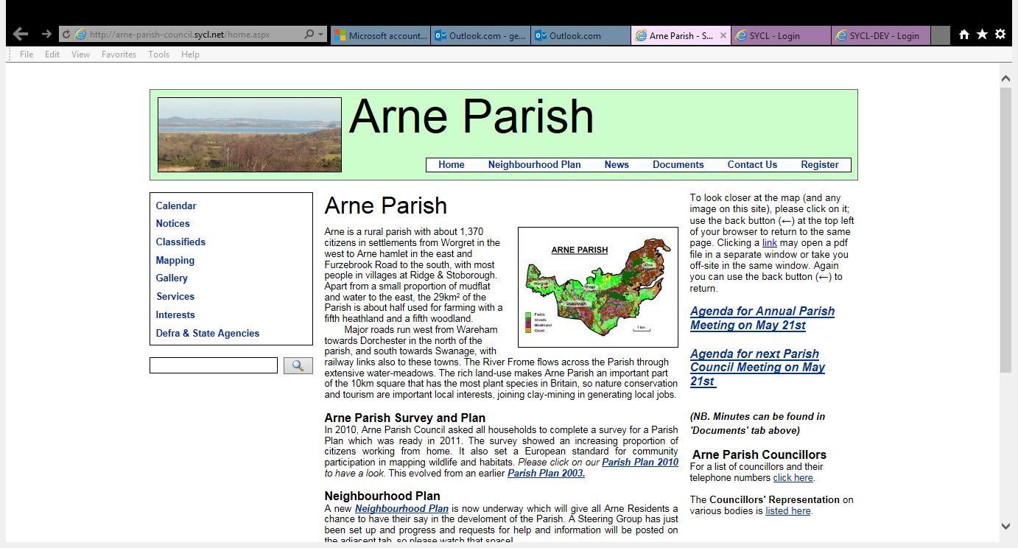

Slide 4
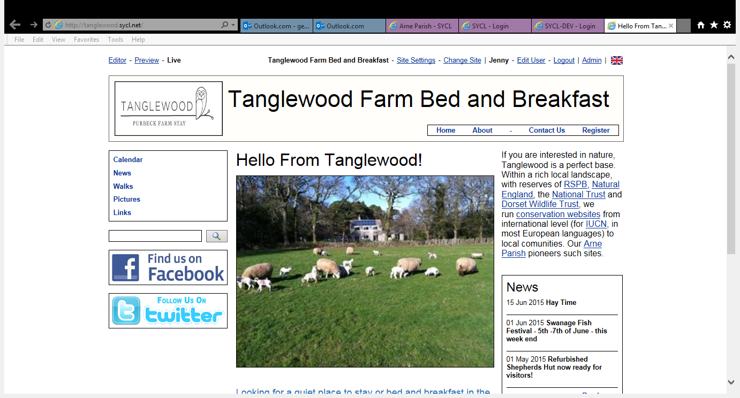

Slide 5
Acquire Login
Request login facility
Who/where from/ to?
Receive email with link
Create your password
login

Slide 6
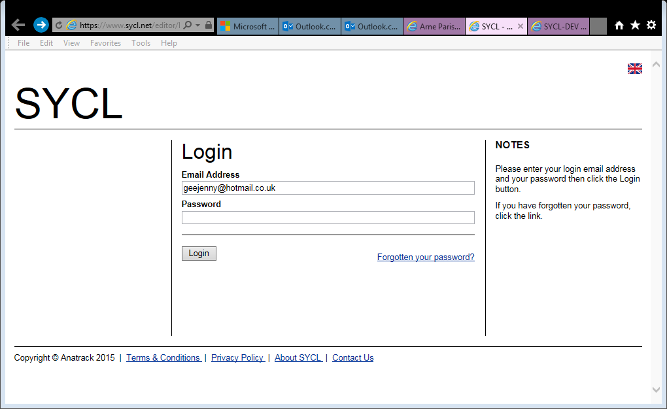
Using the Editor
Login to this page
https://www.sycl.net/editor/login.aspx

Slide 7
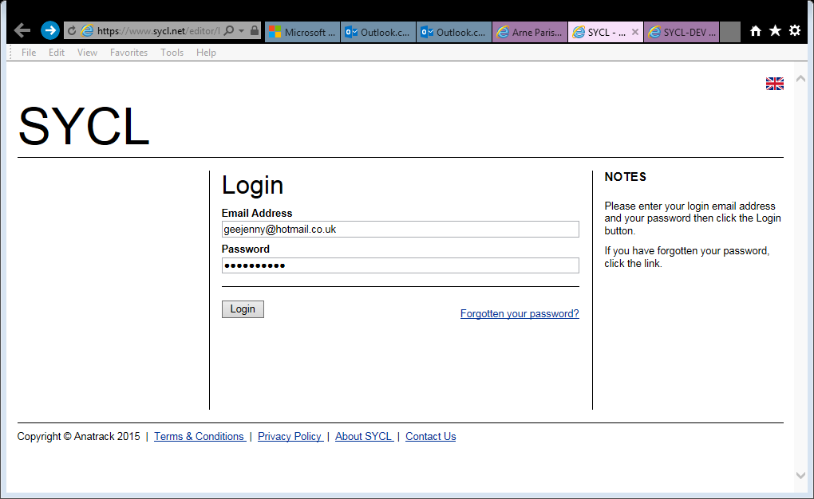

Slide 8
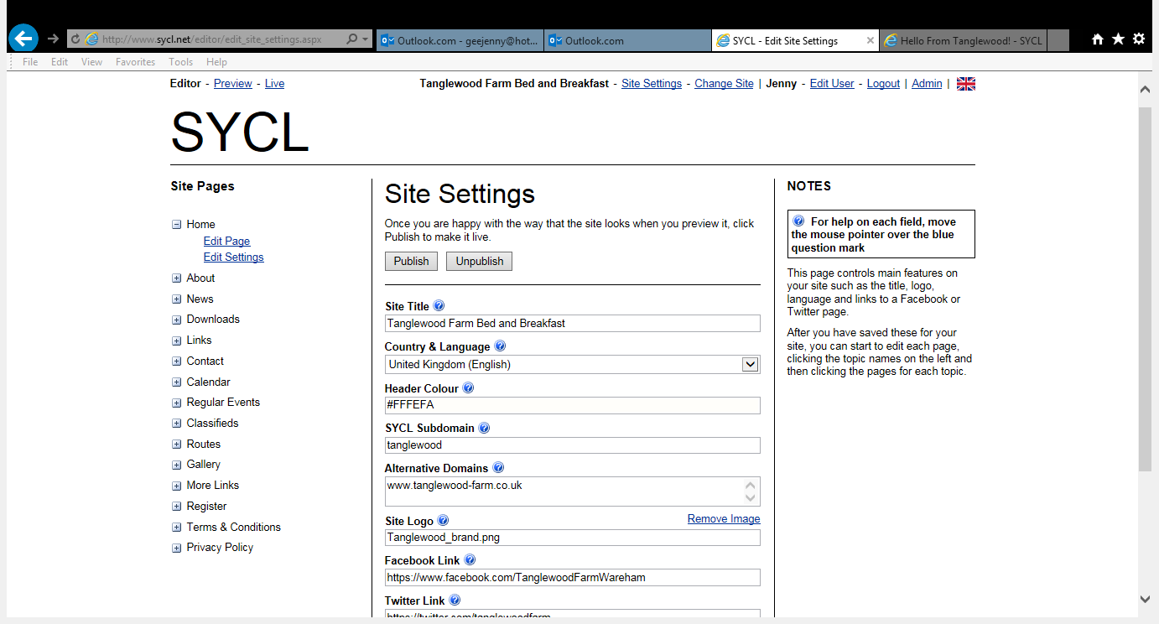
Notes:
Please note that this page (Site Settings) is the place where you will need to publish your work

Slide 9
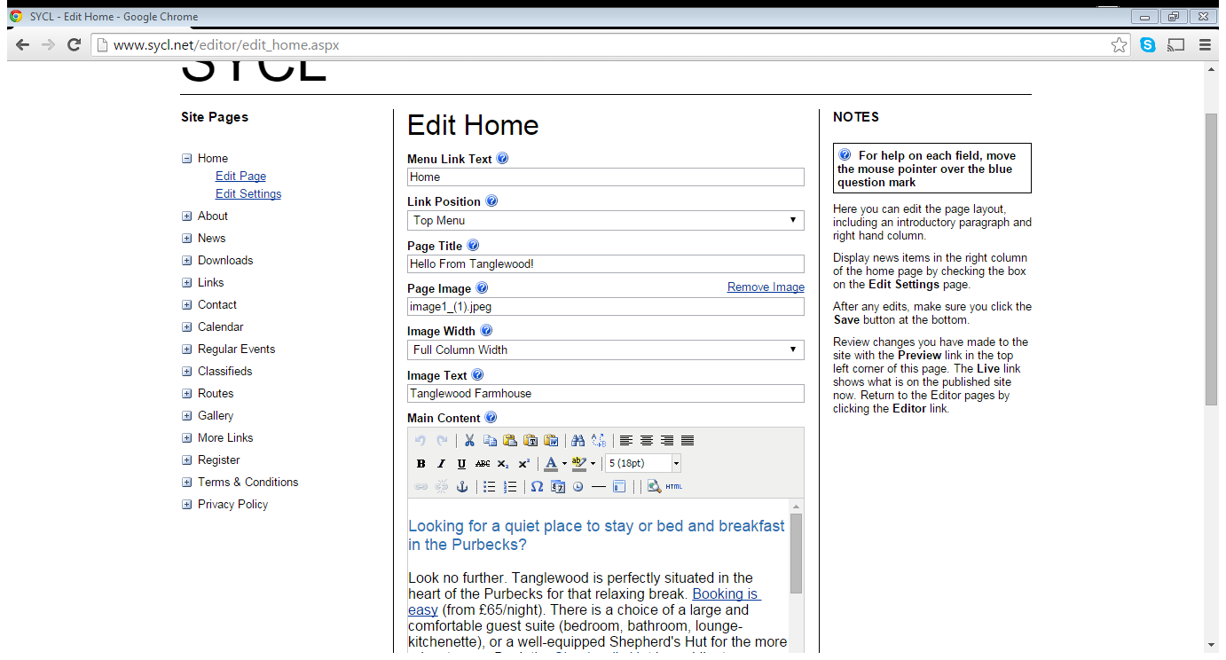
Create Titles & Content
Save your work! – it will tell you at the bottom data saved

Slide 10
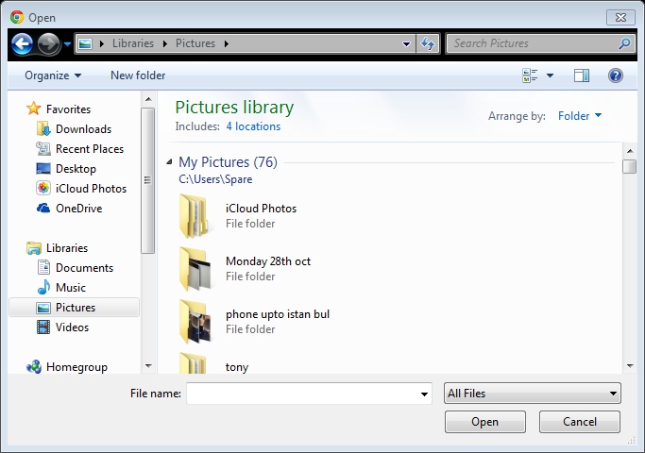
Inserting a picture
Notes:
When you click on the image file box it will automatically open your files for you to choose a picture. Click on your chosen image and this will upload to the web site

Slide 11
Going Live
Although data saved this is not on yet on your website
So
Go back to site settings page
And look for the Publish button and click on this

Slide 12
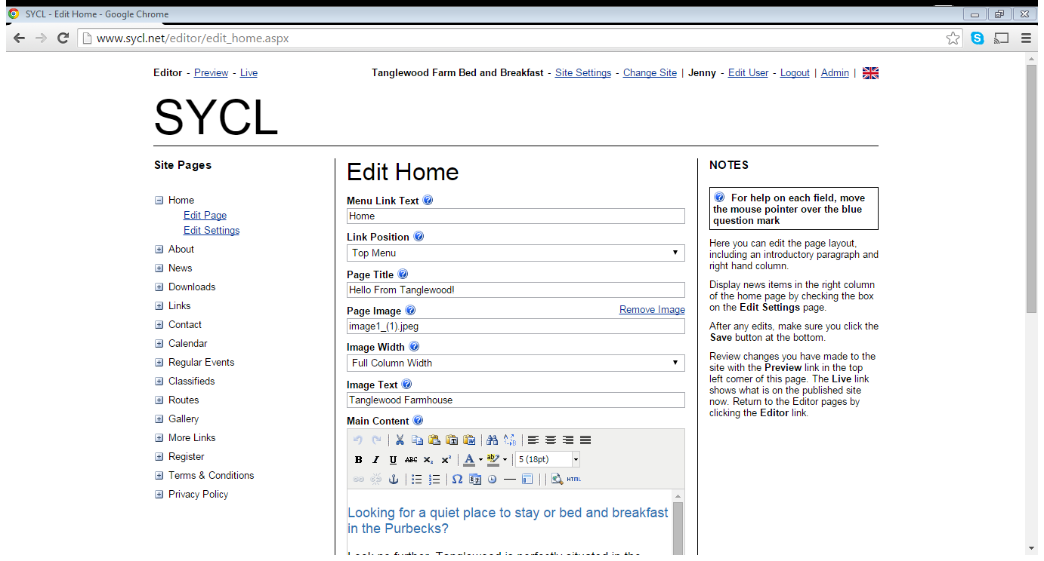

Slide 13
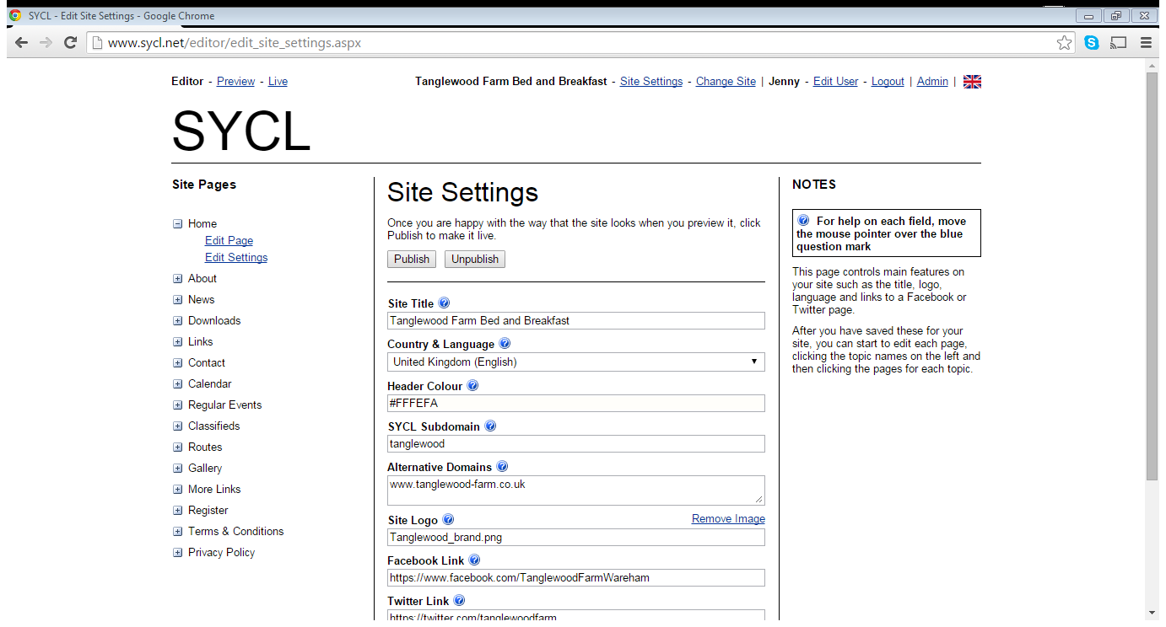

Slide 14
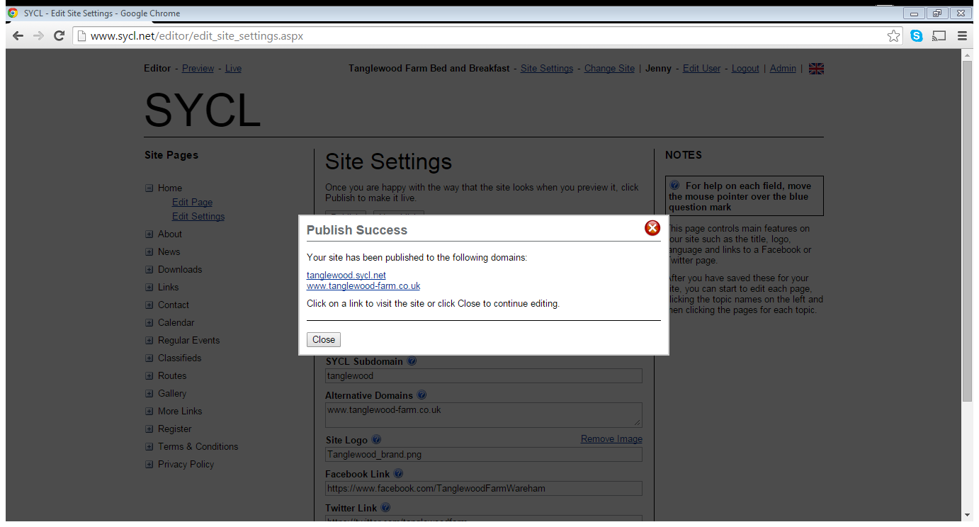

Slide 15
Adding Links
Type in the words you would like to use to link
Eg: Find us
Copy the relevant url on to your clip board
Then highlight your link words with the cursor
Press the link Icon
Paste the url in

Slide 16
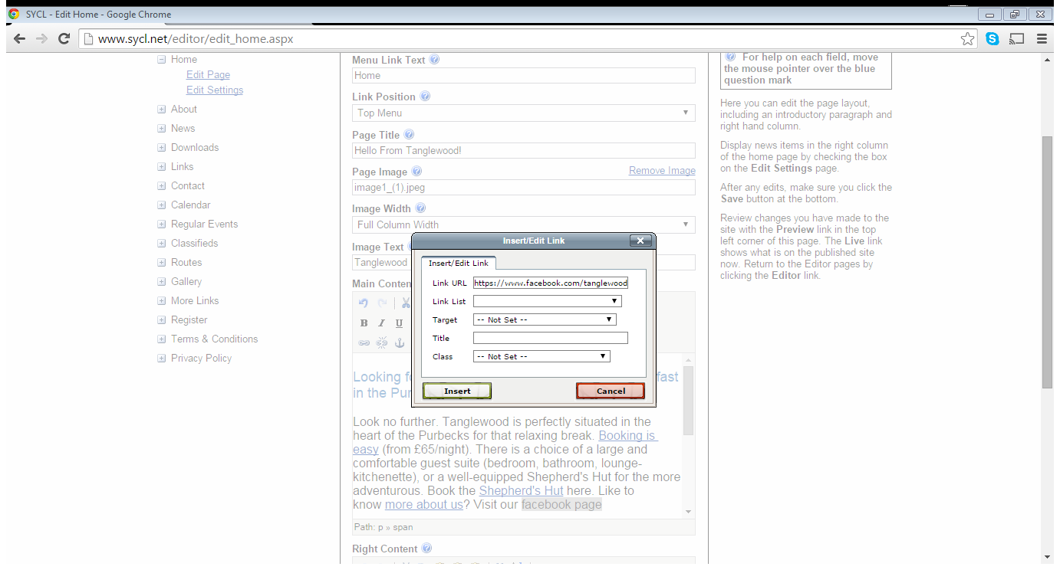

Slide 17
More…..
Bring your news page to the home page
Change the height of photos
Change the colour of the banner
Maps

Slide 18
Have a go
Enlarging photo
Setting up a map
Saving documents

